Slide 1


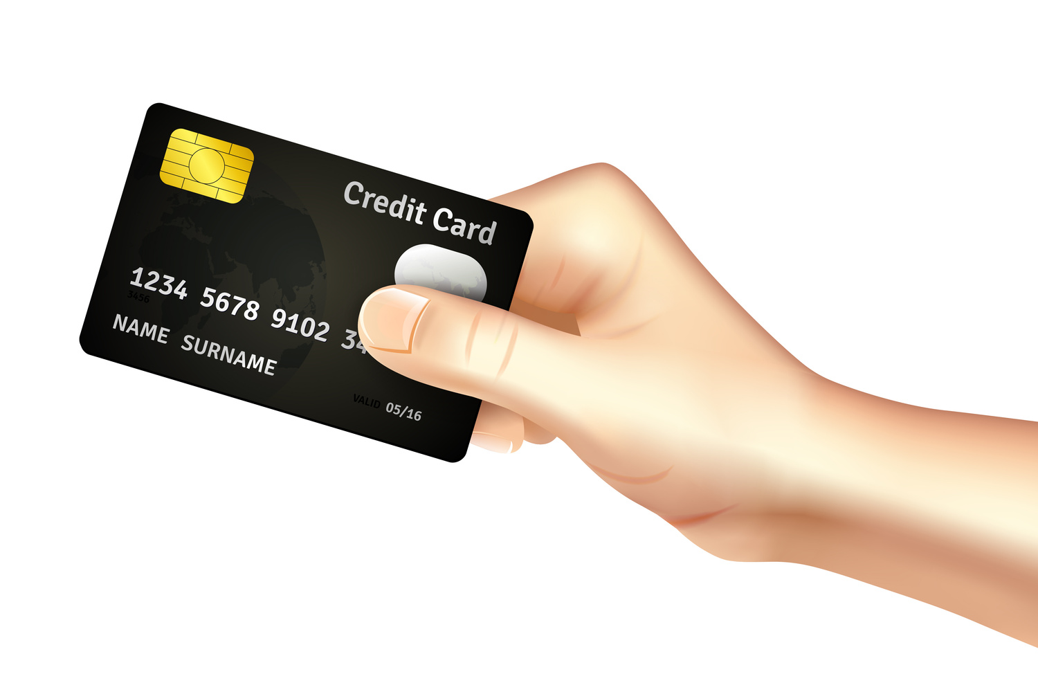
Provide Insights to the Product Strategy Team
Banking Domain
Mitron Bank
Created by
G Viswavardhan Reddy

Slide 2
Problem Statement
Mitron Bank is a legacy financial institution headquartered in Hyderabad. They want to introduce a new line of credit cards to broaden their product offerings and reach the financial market.
AtliQ Data Services came to know about this through an internal link and approached Mitron Bank with a proposal to implement this project. However, the strategy director of Mitron Bank, Mr. Bashnir Rover is skeptical and asked them to do a pilot project with the sample data before handing over the full project. They provided a sample dataset of 4000 customers across five cities on their online spending and other details.
Expectations:
The analysis is expected to guide the product strategy team of Mitron Bank in tailoring credit cards based on customer needs and market trends.
Dataset:
May
June
July
August
September
October
customer_id
age_group
city
gender
marital status
occupation
avg_monthly_income
customer_id
month
category
payment_type
spend
dim_customers
fact_spends

Slide 3
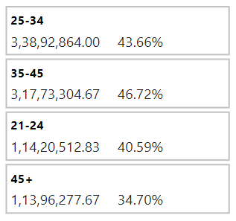
Approach
The customer’s expense might vary from month to month for the same category, so I have used the average monthly expense of the customer in the dashboard by aggregating six months of spending.
Average Monthly Expense = (May + June + July + August + September + October) spends / 6
Why 35-45 age group have a higher Income Utilization % than the 25-34, even though the absolute expense is less?
Because the incomes of both groups are different, I have used their expense % to find customers eligible for new lines of credit cards.
Across Demographics
percentage contribution of each expense category to the total spending across all groups of selected customer demographics.
Within Demographics
percentage contribution of each expense category to the total spending within each group.

Slide 4
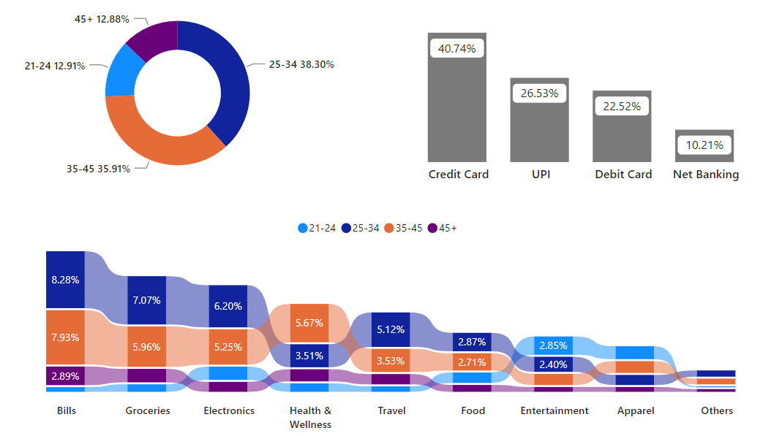
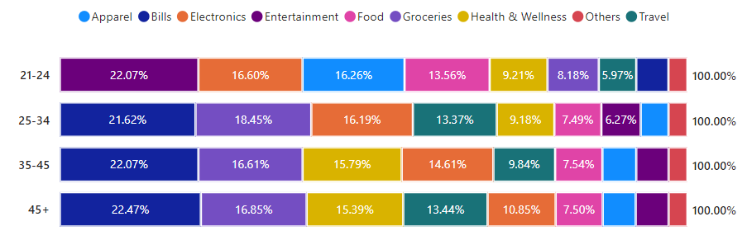
Age Group
25-34 and 35-45 are high-value customers for new credit cards.
25-34 for all categories - more importantly (bills, groceries, electronics, travel, and food)
35-45 for categories - more importantly (bills, groceries, electronics, and health and wellness).
Does this mean the rest of the groups are not eligible?
No
The 21-24 age group spends 22.07% expense on entertainment. They can be offered credit cards with entertainment brands like BookMyShow, INOX Cinemas, PVR Cinemas...
45+ for categories - more importantly (bills, groceries, and health and wellness).

Slide 5
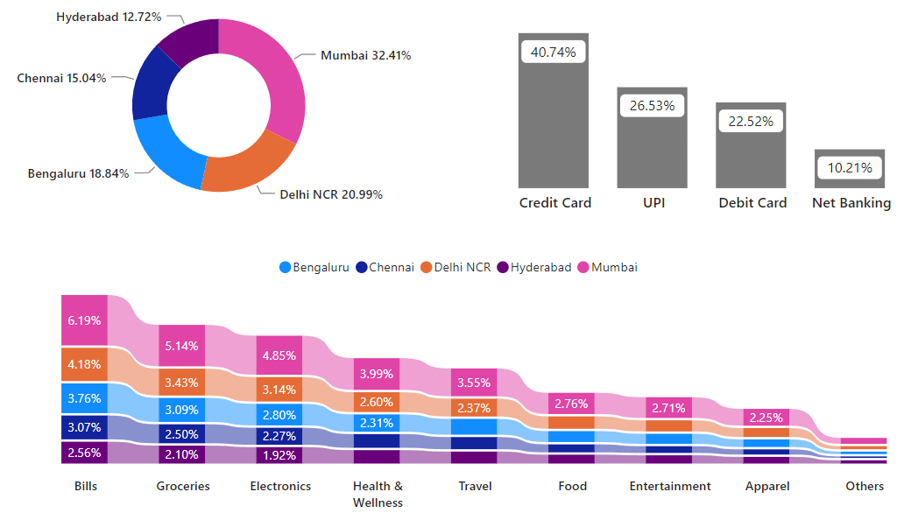
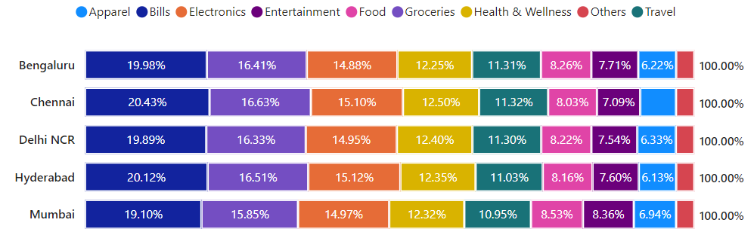
City
Mumbai, Delhi, and Bengaluru are high-value customers for new credit cards for all categories - more importantly (bills, groceries, electronics, health and wellness, and travel).
Does this mean the rest of the groups are not eligible?
No
Chennai and Hyderabad are also eligible for specific category-wise credit cards (bills, groceries, and electronics...)

Slide 6
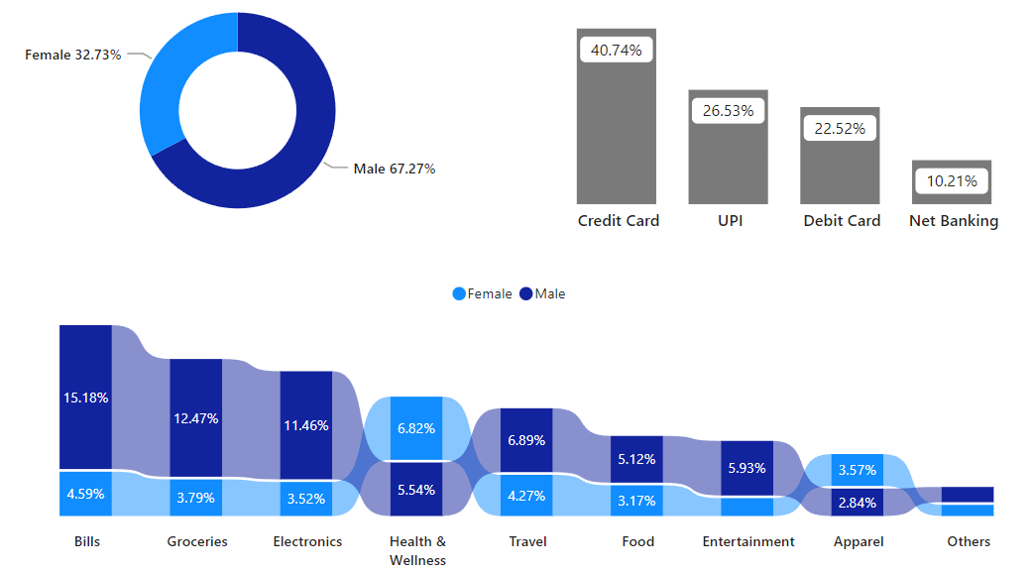
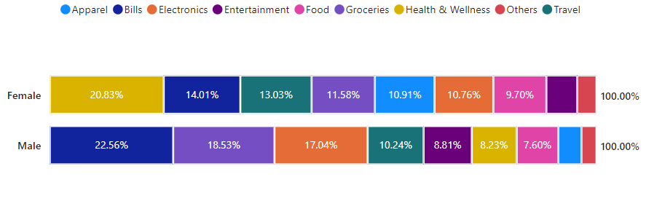
Gender
Males are high-value customers for new credit cards for all categories - more importantly (bills, groceries, electronics, travel, food, and entertainment).
Does this mean the rest of the groups are not eligible?
No
Females are also eligible for specific category-wise credit cards (Health and wellness and apparel). They can be offered credit cards with a wide range of benefits, such as
discounts on annual doctor checkups
complimentary fitness sessions
free video consultations with doctors, and many more.

Slide 7
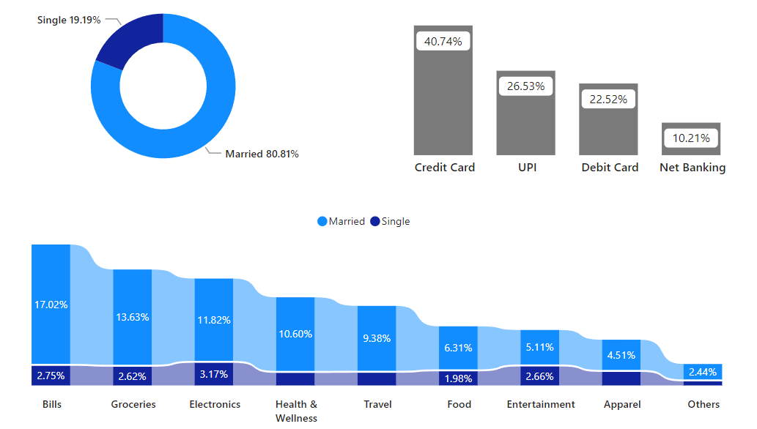
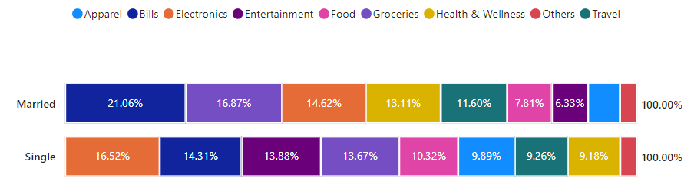
Marital Status
Married are high-value customers for new credit cards for all categories - more importantly (bills, groceries, electronics, health and wellness, and travel).
Does this mean the rest of the groups are not eligible?
No
Singles are also eligible for specific category-wise credit cards (electronics, bills, and entertainment...)

Slide 8
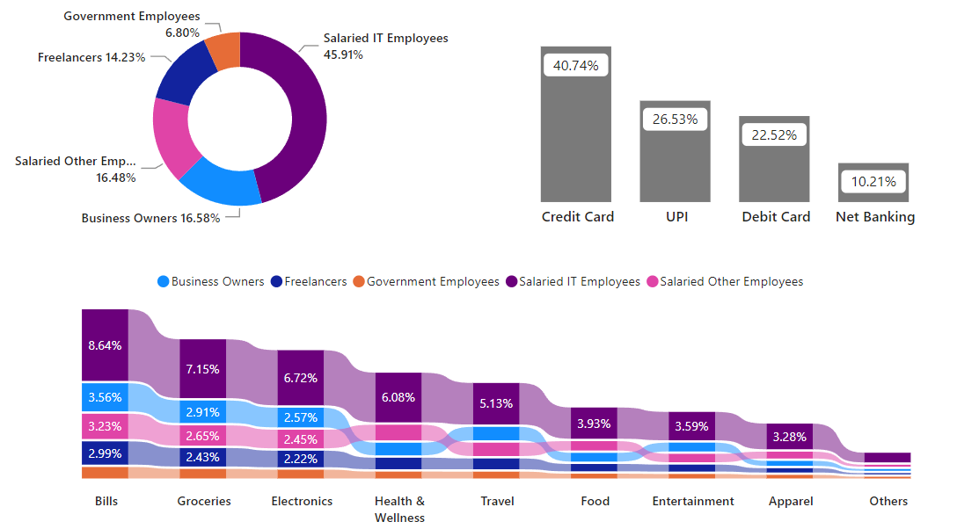
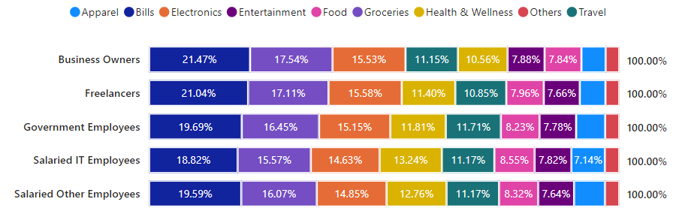
Occupation
Salaried IT employees, Business owners, and other employees are high-value customers for new credit cards.
IT employees for all categories - more importantly (bills, groceries, electronics, health and wellness, and travel)
Business owners for categories (bills, groceries, electronics, travel and entertainment). They spend more on travel and can be offered credit cards with benefits like
complimentary lounge access
free flight tickets
co-branded benefits with airlines or travel partners, and many more...
Other employees for categories (bills, groceries, electronics, health and wellness, and food).
Does this mean the rest of the groups are not eligible?
No
Freelancers and Government employees are also eligible for specific category-wise credit cards (bills, groceries, and electronics...)

Slide 9
THANK YOU
Very Much
Live Dashboard Link

